Slide 2
THE NEW WORLD KIDNEY DAY LOGO
Available in 20+ languages on the WKD website, check if your language is available and share it with your network!

Slide 3
WORLD KIDNEY DAY 2024
Marked on 14 March 2024
Theme is “Kidney Health for All: Advancing equitable access to care and optimal medication practice”
The 2024 campaign focuses on raising awareness of the importance of ensuring equitable access to appropriate treatment and care for people living with kidney disease, in order to improve their quality of life and delay the progression of the disease.

Slide 4
WORLD KIDNEY DAY 2024
Material and resources available
The 2024 campaign visuals
Social media banners
Website banners
Social media posts
Photo Frame
PowerPoint slide
The general paragraph
Highlight the different issues raised by the 2024 theme
Intended to the general public
Used for communication purposes (WKD theme page) and for communication materials (flyers)

Slide 5
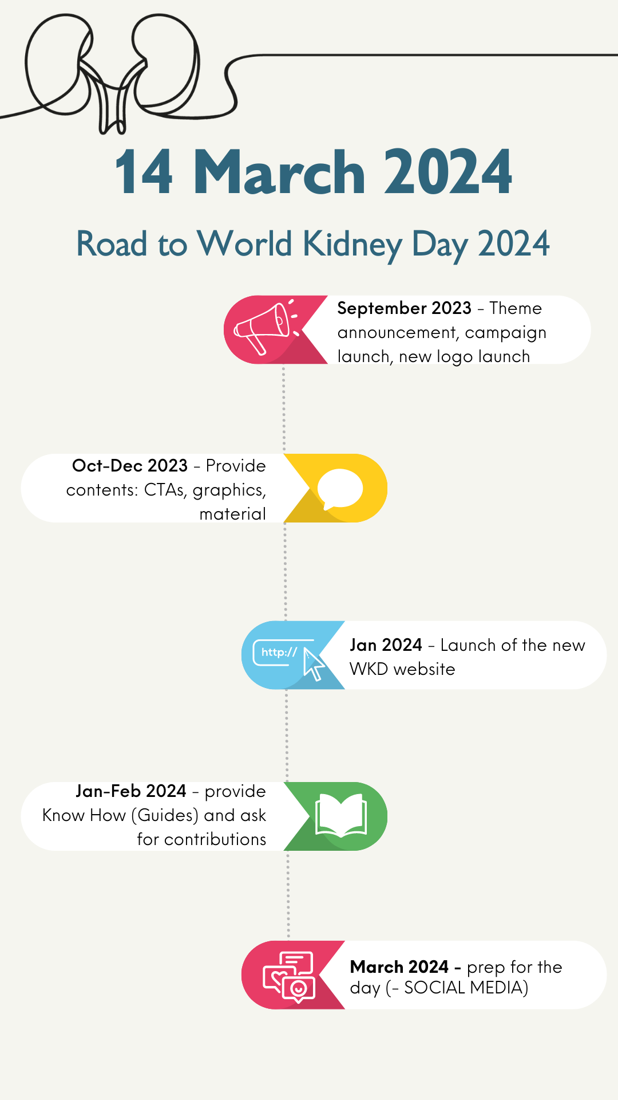
HOW TO GET INVOLVED
Share the WKD message with your community on social media and tag WKD!
Organize or take part in a WKD activity to mark the day and pin it to the WKD map
Share your kidney story! As a nephrologists or healthcare worker, you can share your story and experience. If you are interested in the 2024 blog series, you can send an email at : martina@worldkidneyday.org
Subscribe to the WKD newsletter to keep UpToDate with the campaign
Become a WKD champion and help us raise awareness about kidney disease

